Slide 1
Binary Search Tree Lecture 10

Slide 2
Binary Search Tree
It’s a binary tree !
For each node in a BST
left subtree is smaller than it
right subtree is greater than it

Slide 3
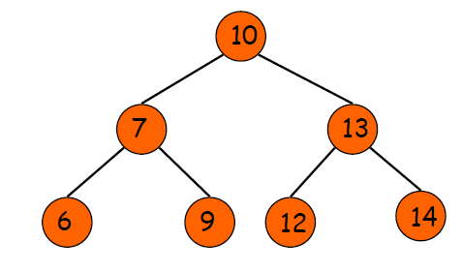
Example
Notes:
Here are some of the data structures we have studied so far:Compare to linked lists, trees are non-linear data structures.
In a linked list, each node has a link which points to another node.
In a tree structure, however, each node may point to several nodes, which may in turn point to several other nodes.
Thus, a tree is a very flexible and a powerful data structure that can be used for a wide variety of applications
Arrays
Singly-linked lists and doubly-linked lists
Stacks, queues, and deques
Sets
These all have the property that their elements can be adequately displayed in a straight line

Slide 4
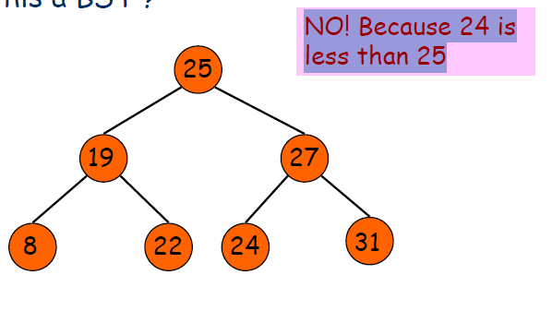
Example
Is this a BST ?

Slide 5
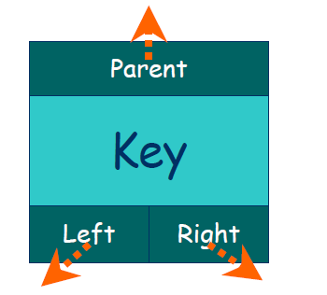
Node structure

Slide 6
Node structure
class Node {
int key;
Node left, right;
public Node(int item) {
key = item;
left = right = null;
}
}

Slide 7
Binary Search Tree
class BinarySearchTree {
// Root of BST
Node root;
// Constructor
BinarySearchTree() {
root = null;
}
// other functions …
}

Slide 8
Operations
There are 3 common operations:
INSERT
QUERY
DELETE

Slide 9
Operation - Insert
Insert(T,z)
Insert a node with KEY=z into BST T
Time complexity: O(h)

Slide 10
Operation - Insert
Step1: if the tree is empty,
then Root(T)=z
Step2: Else, Search for z in BST T, until we meet a null node
Step3: Insert z

Slide 11
ALGORITHM
NEWNODE is a pointer variable to hold the address of the newly created node. DATA is the information to be pushed.
1. Input the DATA to be pushed and ROOT node of the tree.
2. NEWNODE = Create a New Node.
3. If (ROOT == NULL)
(a) ROOT=NEW NODE
4. Else If (DATA < ROOT → Info)
(a) ROOT = ROOT → Lchild
(b) GoTo Step 4
5. Else If (DATA > ROOT → Info)
(a) ROOT = ROOT → Rchild
(b) GoTo Step 4

Slide 12
ALGORITHM
6. If (DATA < ROOT → Info)
(a) ROOT → LChild = NEWNODE
7. Else If (DATA > ROOT → Info)
(a) ROOT → RChild = NEWNODE
8. Else
(a) Display (“DUPLICATE NODE”)
(b) EXIT
9. NEW NODE → Info = DATA
10. NEW NODE → LChild = NULL
11. NEW NODE → RChild = NULL
12. EXIT

Slide 13
Insert()
/* A recursive function to insert a new key in BST */
Node insertRec(Node root, int key) {
/* If the tree is empty, return a new node */
if (root == null) {
root = new Node(key);
return root;
}
/* Otherwise, recur down the tree */
if (key < root.key)
root.left = insertRec(root.left, key);
else if (key > root.key)
root.right = insertRec(root.right, key);
/* return the (unchanged) node pointer */
return root;
}

Slide 14
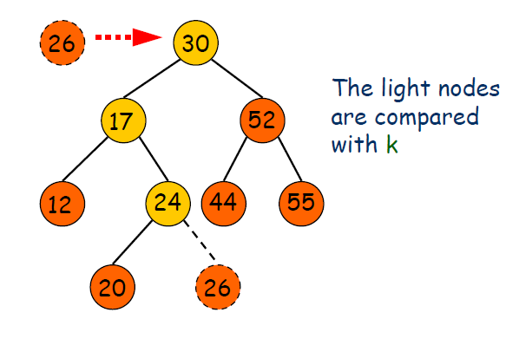
Operation - Insert

Slide 15
Insert()
struct node* insert(struct node* node, int data) { // 1. If the tree is empty, return a new, single node if (node == NULL) { return(newNode(data)); } else { // 2. Otherwise, recur down the tree if (data <= node->data)
node->left = insert(node->left, data);
else
node->right = insert(node->right, data);
return(node); // return the (unchanged) node pointer } }

Slide 16
Operation - Query
The QUERY operation can be further spit into:
Search
Max/Min
Successor/Predecessor

Slide 17
Operation - Search
Search(T,k)
search the BST T for a value k

Slide 18
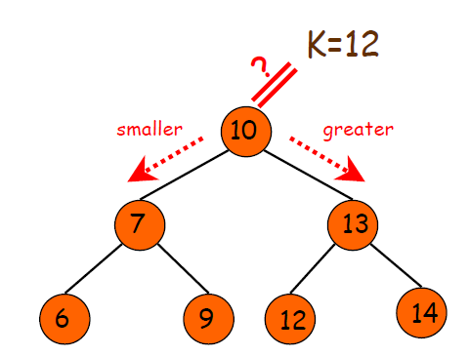
Operation - Search

Slide 19
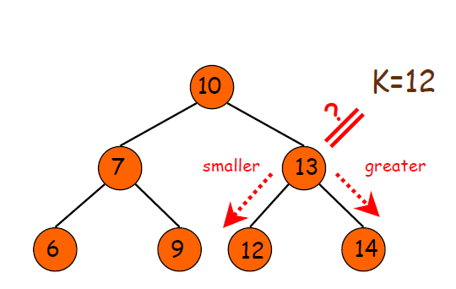
Operation - Search

Slide 20
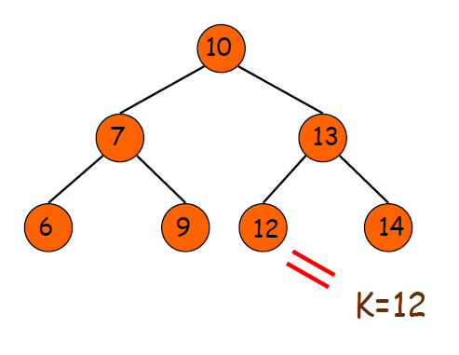
Operation - Search

Slide 21
ALGORITHM
1. Input the DATA to be searched and assign the address of the root node to ROOT.
2. If (DATA == ROOT → Info)
(a) Display “The DATA exist in the tree”
(b) GoTo Step 6
3. If (ROOT == NULL)
(a) Display “The DATA does not exist”
(b) GoTo Step 6
4. If(DATA > ROOT→Info)
(a) ROOT = ROOT→RChild
(b) GoTo Step 2
5. If(DATA < ROOT→Info)
(a) ROOT = ROOT→Lchild
(b) GoTo Step 2
6. Exit

Slide 22
Search()
// A function to search a given key in BST
public Node search(Node root, int key)
{
// Base Cases: root is null or key is present at root
if (root==null || root.key==key)
return root;
// val is greater than root's key
if (root.key > key)
return search(root.left, key);
// val is less than root's key
return search(root.right, key);
}

Slide 23
Search()
static int lookup(struct node* node, int target) { // 1. Base case == empty tree // in that case, target is not found so return false if (node == NULL) { return(false); } else { // 2. see if found here if (target == node->data)
return(true); else { // 3. otherwise recur down the correct subtree if (target < node->data)
return(lookup(node->left, target)); else return(lookup(node->right, target)); } } }
Notes:
Given a binary search tree and a "target" value, search the tree to see if it contains the target. The basic pattern of the lookup() code occurs in many recursive tree algorithms: deal with the base case where the tree is empty, deal with the current node, and then use recursion to deal with the subtrees. If the tree is a binary search tree, there is often some sort of less-than test on the node to decide if the recursion should go left or right.

Slide 24
Operation - Search
Search operation takes time O(h), where h is the height of a BST

Slide 25
Operation –Min/Max
For Min, we simply follow the left pointer until we find a null node
Why? Because if it’s not the minimum node, then the real min node must reside at some node’s right subtree. By the property of BST, it’s a contradiction
Similar for Max
Time complexity: O(h)

Slide 26
Operation –Min/Max
findMin( Node* t )
{
if( t == NULL )
return NULL;
if( t->left == NULL )
return t;
return findMin( t->left);
}
findMax( Node* t )
{
if( t != NULL )
while( t->right != NULL )
t = t->right;
return t;
}

Slide 27
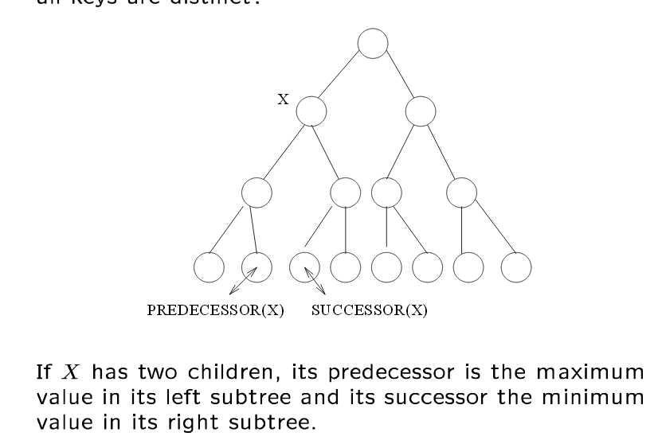
Operation Predecessor/Successor

Slide 28
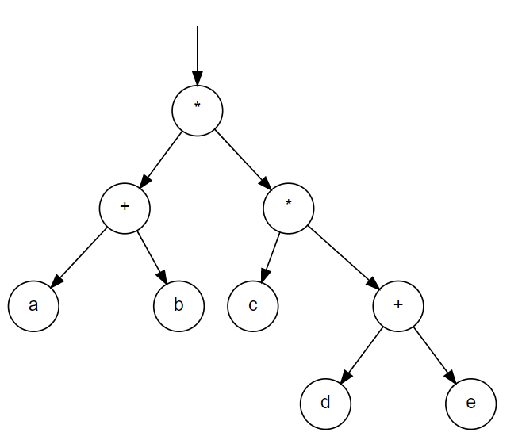

Slide 29
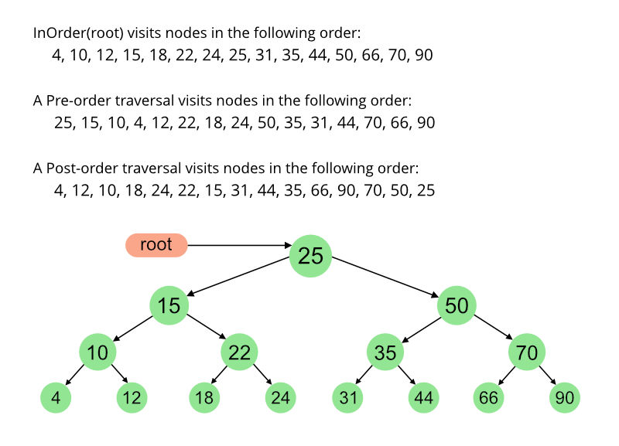

Slide 30
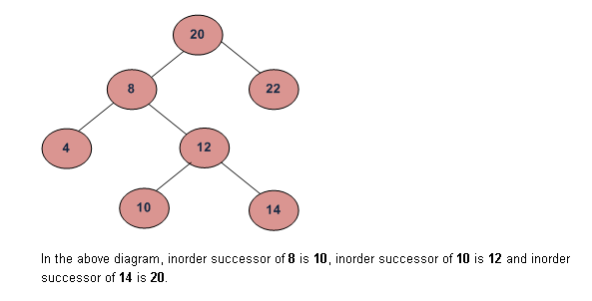
Operation Predecessor/Successor

Slide 31
Operation Predecessor/Successor
// A utility function to do inorder traversal of BST
void inorderRec(Node root)
{
if (root != null)
{
inorderRec(root.left);
System.out.print(root.key + " ");
inorderRec(root.right);
}
}

Slide 32
Operation Predecessor/Successor
Successor(x)
If we sort all elements in a BST to a sequence,
return the element just after x
Time complexity: O(h)

Slide 33
Operation - Delete
Delete (T,z)
Delete a node with key=z from BST T
Time complexity: O(h)

Slide 34
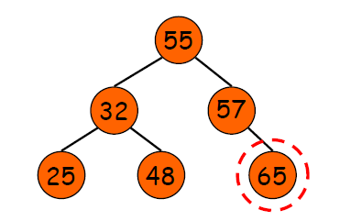
Operation - Delete
Case 1: z has no child

Slide 35
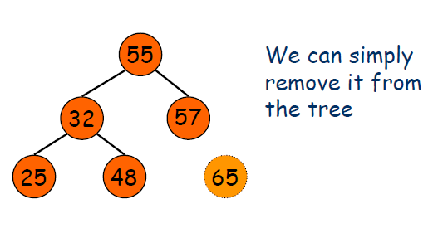
Operation - Delete

Slide 36
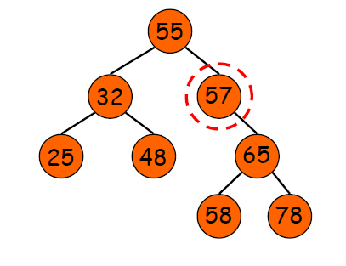
Operation - Delete
Case 2: z has one child

Slide 37
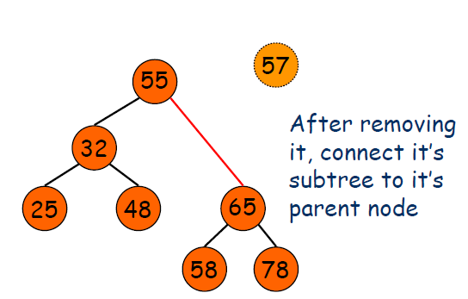
Operation - Delete

Slide 38
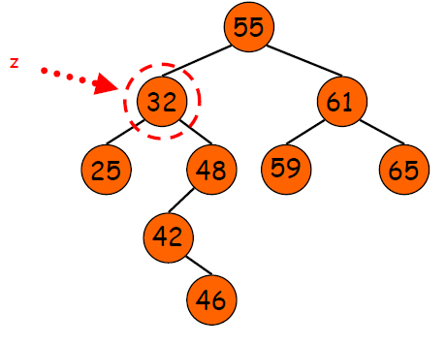
Operation - Delete
Case 3: z has two child

Slide 39
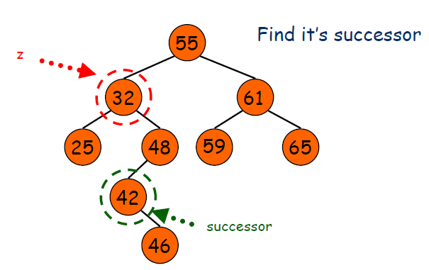
Operation - Delete

Slide 40
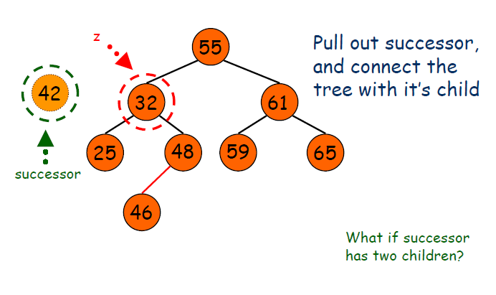
Operation - Delete

Slide 41
Operation - Delete
What if the successor has two nodes?
Not possible ! Because if it has two nodes, at least one of them is less than it, then in the process of finding successor, we won't pick it !

Slide 42
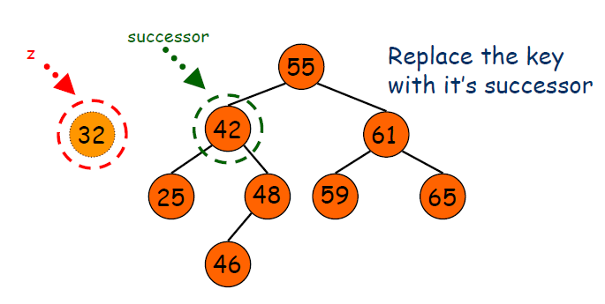
Operation - Delete

Slide 43
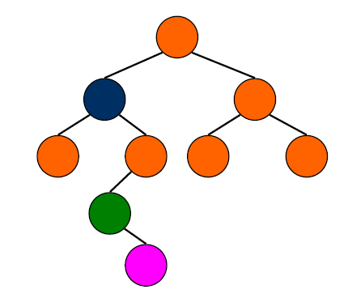
Operation - Delete

Slide 44
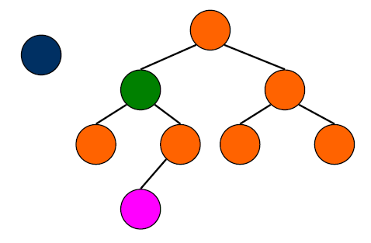
Operation - Delete

Slide 45
Operation - Delete

Slide 46
Operation - Delete

Slide 47
The Hibbard node deletion algorithm
if ( k not in BST ) {
return; // Nothing to delete
}
/****** The "Hibbard deletion algorithm" ******/
if ( k has no subtrees ) { // x x
unlink k from k's parent; // / \ ==> /
return; // y k y
}
if ( k has 1 tree ) { // x x
make k's parent point to k's subtree; // / \ ==> / \
return; // y k y z
} // \
// z
/* k has 2 subtrees - TOUGH */
(1) find the successor of k:
go right once
go left all the way down
(2) Replace k with k's successor;
(3) Make the successor's parent point to the successor's right subtree;

Slide 48
Sources used
Lectures by Mr. Mohammad Asad Abbasi

